Slide 1



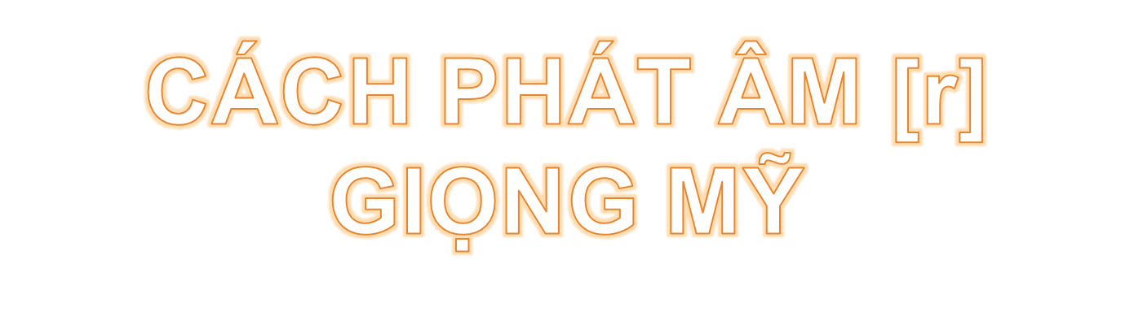

Slide 2

15 phút đầu: Ôn lại âm [d]
15 phút tiếp: Âm mới - âm [r]
30 phút tiếp: thực hành âm [r]
15 phút tiếp: Game phát hiện giọng Mỹ
15 phút cuối: bài đọc VOA

Slide 3

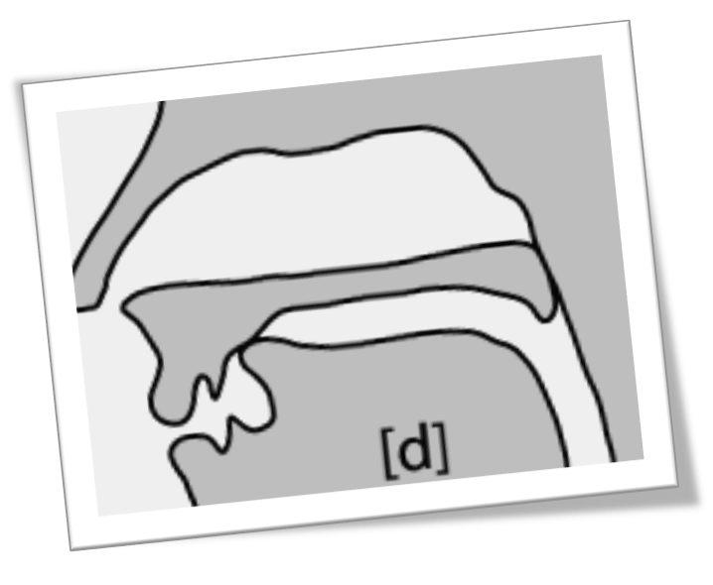
- Bước 1: đặt đầu lưỡi lên vòm miệng trên (không chạm răng hàm trên)
- Bước 2: không vận hơi gió như âm [t] mà vận dây thanh và trượt lưỡi về phía trước, phát ra âm như: d hoặc [dia] (trong tiếng Việt)

Slide 4

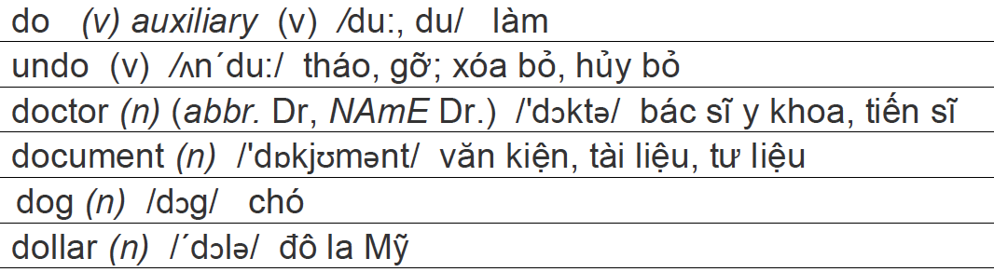
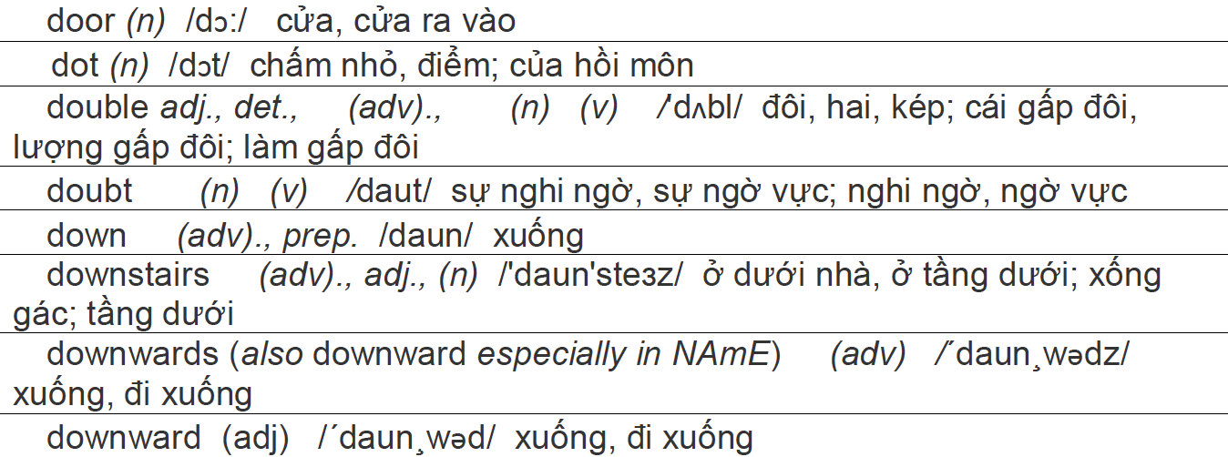

Slide 5

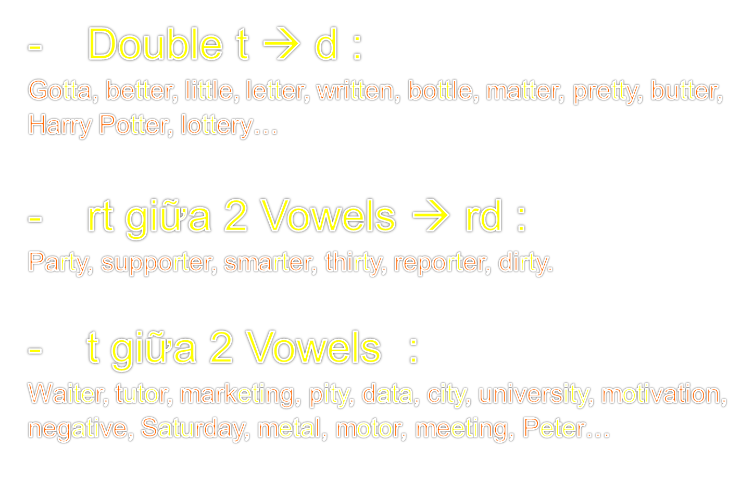

Slide 6


Slide 7
15 phút đầu: Ôn lại âm [d]
15 phút tiếp: Âm mới - âm [r]
30 phút tiếp: thực hành âm [r]
15 phút tiếp: Game phát hiện giọng Mỹ
15 phút cuối: bài đọc VOA

Slide 8

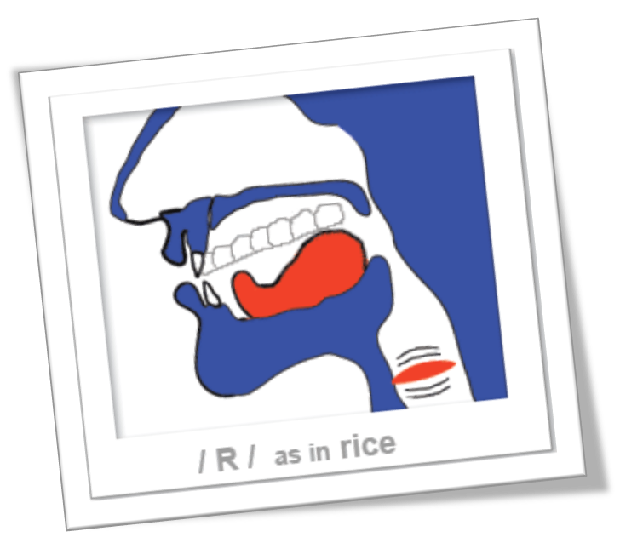
- Âm [r] là âm hữu thanh mạnh và đặc trưng của giọng Mỹ.
- Ở bất cứ vị trí nào trong từ, âm [r] trong giọng Mỹ đều được phát ra rõ và mạnh.

Slide 9
- Bước 1: cong đầu lưỡi về phía sau. Tránh đầu lưỡi đụng vòng miệng trên.
- Bước 2: giữ nguyên vị trí lưỡi đó và phát ra âm A như âm A của tiếng Việt

Slide 10
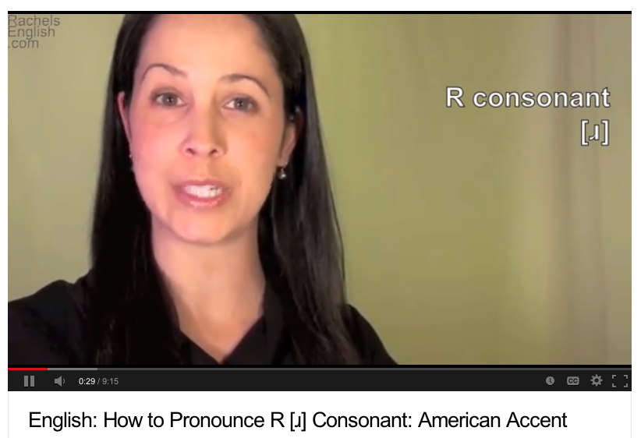
English: How to Pronounce R [ɹ] Consonant: American Accent
http://www.youtube.com/watch?v=Jq_yIbrD01c

Slide 11
15 phút đầu: Ôn lại âm [d]
15 phút tiếp: Âm mới - âm [r]
30 phút tiếp: thực hành âm [r]
15 phút tiếp: Game phát hiện giọng Mỹ
15 phút cuối: bài đọc VOA

Slide 12
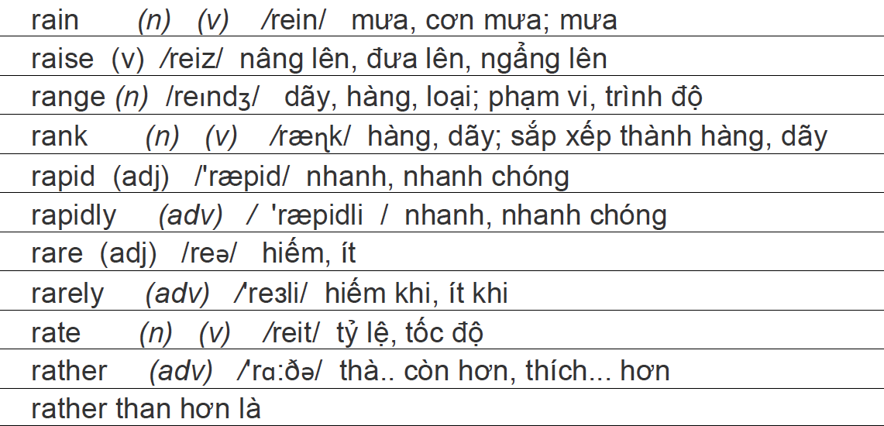
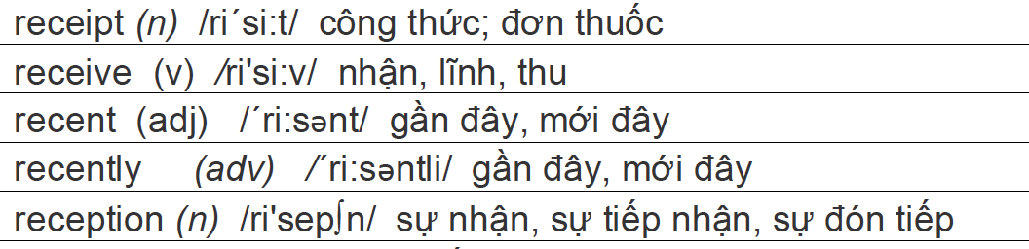

Slide 13
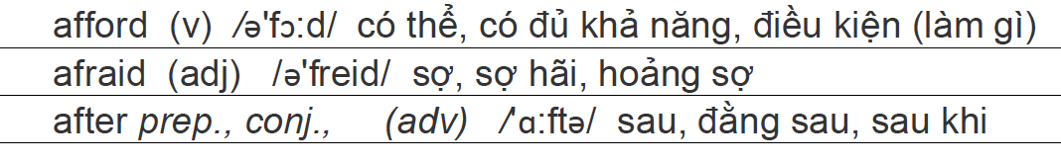
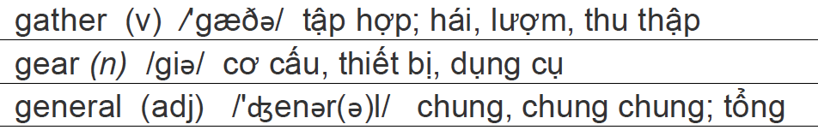
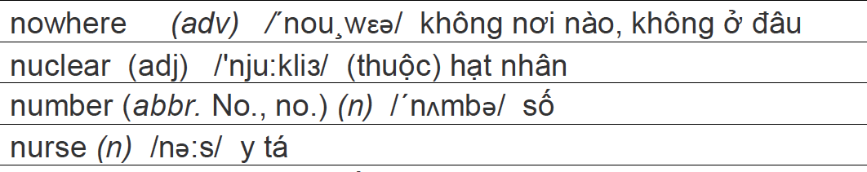

Slide 14
15 phút đầu: Ôn lại âm [d]
15 phút tiếp: Âm mới - âm [r]
30 phút tiếp: thực hành âm [r]
15 phút tiếp: Game phát hiện giọng Mỹ
15 phút cuối: bài đọc VOA

Slide 15



Slide 16
15 phút đầu: Ôn lại âm [d]
15 phút tiếp: Âm mới - âm [r]
30 phút tiếp: thực hành âm [r]
15 phút tiếp: Game phát hiện giọng Mỹ
15 phút cuối: bài đọc VOA

Slide 17

Giving Thanks for a Winning Soccer Team
Nguồn: http://www.youtube.com/watch?v=dWNWavtjPiw

Slide 18
Giving Thanks for a Winning Soccer Team
I'm Alex Villarreal with the VOA Special English Education Report
Americans celebrated the Thanksgiving holiday on November twenty-fifth.
They gathered with family and friends to share a meal.
Some celebrated the holiday by telling what they are most thankful for.
This holiday season, a group of student-athletes in Woodburn, Oregon has given its community something to be thankful for.
The Woodburn High School boys soccer team has reached the state soccer championship playoffs for twenty-five straight seasons.
But the Bulldogs had never won the state championship -- until this year. Their victory in November also represents a win for their mostly Hispanic hometown.
Writer Steve Wilson spent a year recording the successes and problems of the team.
He wrote a book called "The Boys from Little Mexico: A Season Chasing the American Dream."
It tells about a community struggling with issues such as immigration and cultural changes.

Slide 19
Migrant farm workers from Mexico started coming to Woodburn, Oregon about fifty years ago. Many of the workers stayed and made the town their home. So the town became known as "Little Mexico.”
Steve Wilson thinks the Woodburn boys soccer team's continued hard work and effort to win the state championship is similar to their cultural experiences.
Like many Mexican-Americans, the boys on the Woodburn team faced major problems.
They include poverty, a language barrier and immigration issues. Mr. Wilson wondered if those challenges were preventing the team from reaching its goal of winning a state championship.
So he decided to follow the team for an entire season. He got to know the players, coaches and supporters.
One of the players he writes about in the book is Martin Maldonado-Cortez.
Martin says he and the other boys on the team knew that Woodburn had a bad image.
The town has a population of only twenty-two thousand people.
But it faces many of the same problems found in large cities.
These include gang violence and illegal drugs.
He says when the team went to play other schools the people did not act friendly toward them.
Martin says his coaches told him to show pride in his culture.
They told him to make an effort to be successful in life -- and not just on the field.
For VOA Special English I'm Alex Villarreal. Our programs are online with transcripts and MP3 files at voaspecialenglish.com. And you can find us on Twitter, Facebook and YouTube at VOA Learning English.

